Slide 1
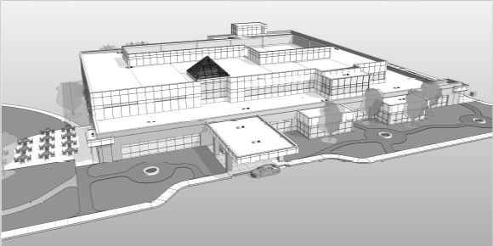
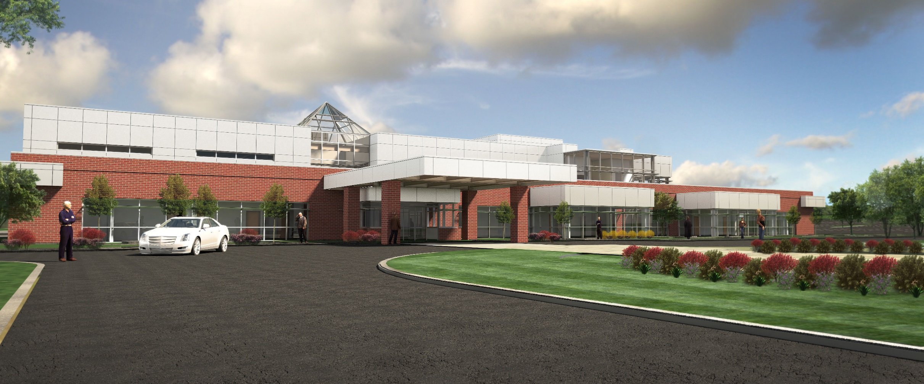
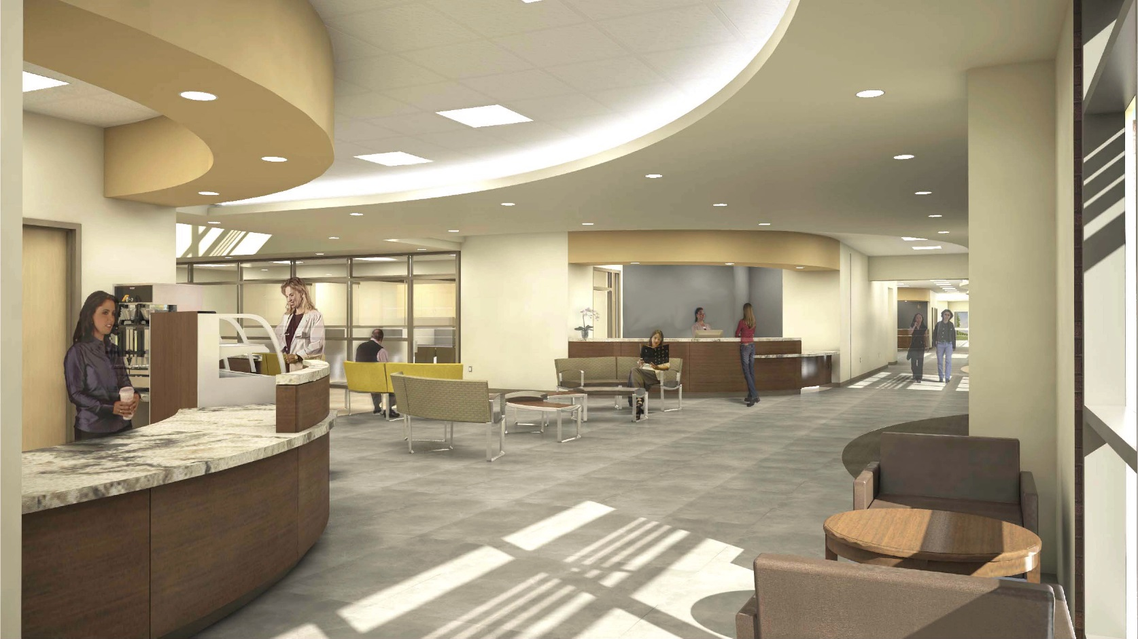
The Medical Office Building
Kale Mullikin
Mechanical Option
Advisor: Donghyun Rim

Slide 2
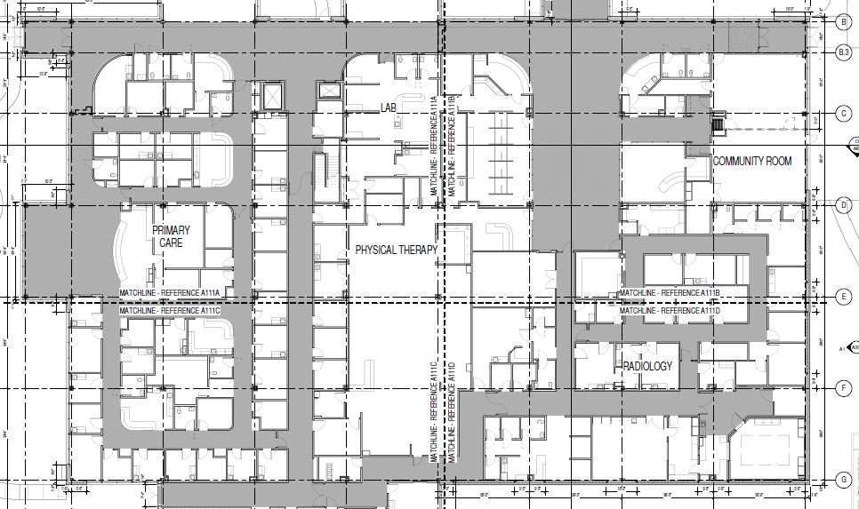
The Medical Office Building Overview
Overview
Existing Conditions
Ground Coupled Depth
System Design Options
Cost Analysis
Structural Breadth
Joist Redesign
Girder Redesign
Cost
Conclusion
Located in North-East United State
Exam, Physical Therapy, Radiology, Small Lab
~73,000 SF
$21.9 Million
Currently Under Construction
Exam
Physical Therapy
Radiology

Slide 3
The Medical Office Building Existing Conditions
Overview
Existing Conditions
Ground Coupled Depth
System Design Options
Cost Analysis
Structural Breadth
Joist Redesign
Girder Redesign
Cost
Conclusion
Packaged Rooftop Units
70 Ton
VAV Reheat
Ductless Split System Units
Propane and Electric
 | Summer Design Cooling (0.4%) | Winter Design Heating (99.6%)
Outdoor Air Dry Bulb (°F) | 92.4 | 9.4
Outdoor Air Wet Bulb (°F) | 74.1 | -
Indoor Air Design Temp (°F) | 75 | 72

Slide 4
The Medical Office Building Trane Modeling
Overview
Existing Conditions
Ground Coupled Depth
System Design Options
Cost Analysis
Structural Breadth
Joist Redesign
Girder Redesign
Cost
Conclusion
Trane TRACE 700
Blocks Defined As:
Conference
Corridor
Lobby
Office
Physical Therapy
Procedure
Reception
Storage
115 Tons
$46,060 Yearly Utility
 | Electric (kWh) | Gas (kBtu) | Total Building Energy (kBtu/yr)
Heating | - | 709,240 | 709,240
Cooling | 204,744 | - | 698,791
Lighting | 529,746 | - | 1,808,024
Receptacles | 115,781 | - | 395,161
 |  |  | 3,611,216

Slide 5
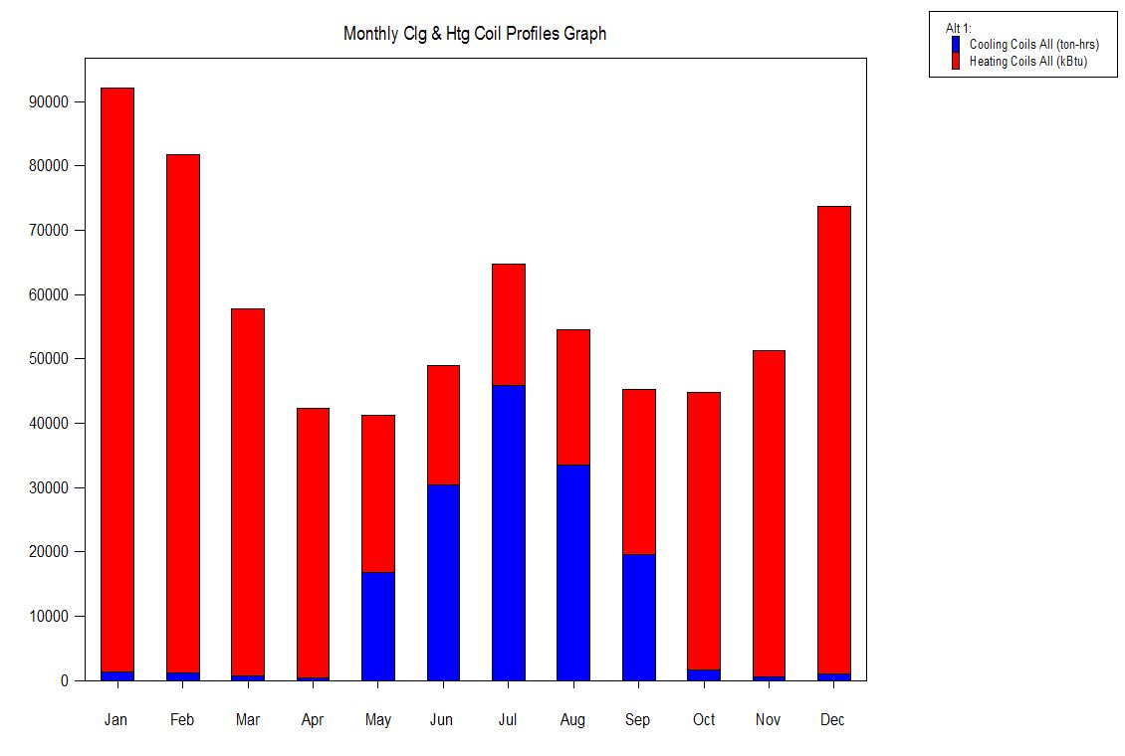
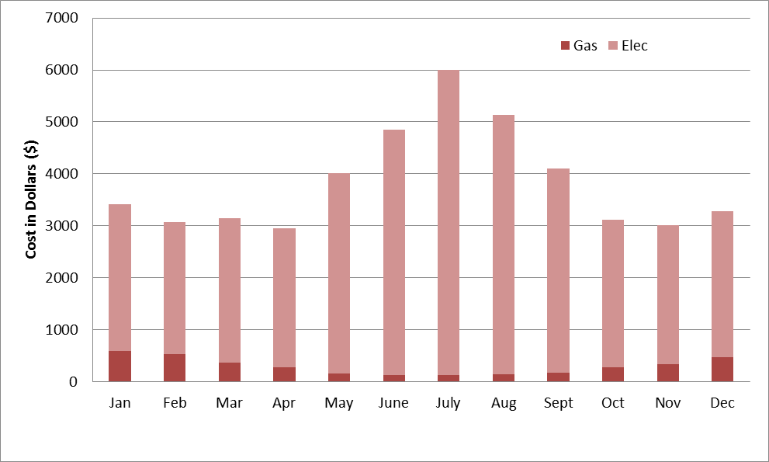
The Medical Office Building Trane Modeling
Overview
Existing Conditions
Ground Coupled Depth
System Design Options
Cost Analysis
Structural Breadth
Joist Redesign
Girder Redesign
Cost
Conclusion

Slide 6
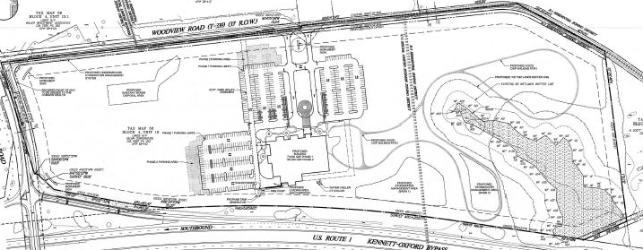
The Medical Office Building Ground Coupled Motivation
Overview
Existing Conditions
Ground Coupled Depth
System Design Options
Cost Analysis
Structural Breadth
Joist Redesign
Girder Redesign
Cost
Conclusion
Large area for ground coupled placement
Eliminate need for propane gas
Potential for large energy savings
Reduce Emissions

Slide 7
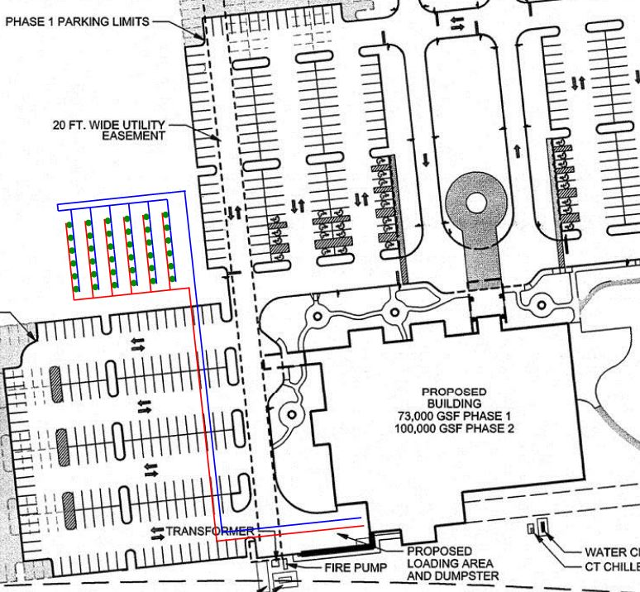
The Medical Office Building Vertical Well
Overview
Existing Conditions
Ground Coupled Depth
System Design Options
Cost Analysis
Structural Breadth
Joist Redesign
Girder Redesign
Cost
Conclusion
Required well length of 10,702 ft
15% factor of safety
36 wells needed
300’ well depth
Well Depth (ft) | Required Length | Number of Wells
100 | 10702 | 108
200 | 10702 | 54
300 | 10702 | 36

Slide 8
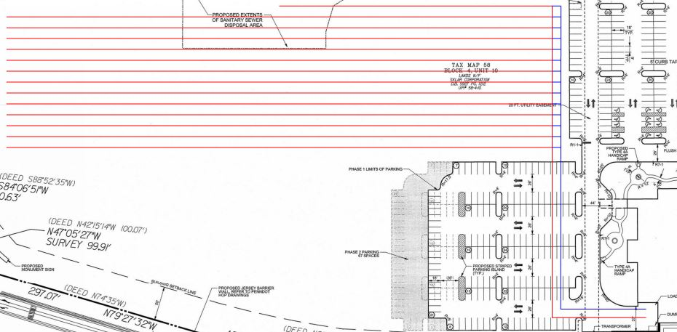
The Medical Office Building Horizontal Well
Overview
Existing Conditions
Ground Coupled Depth
System Design Options
Cost Analysis
Structural Breadth
Joist Redesign
Girder Redesign
Cost
Conclusion
Required Length of 10,702ft
15% factor of safety
13 - 800ft runs
1 – 400ft run
10,800ft total

Slide 9
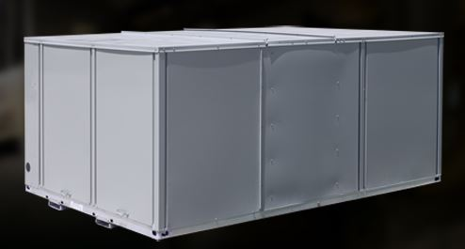
The Medical Office Building Cost Analysis – Rooftop Units
Overview
Existing Conditions
Ground Coupled Depth
System Design Options
Cost Analysis
Structural Breadth
Joist Redesign
Girder Redesign
Cost
Conclusion
Trane Axiom GER 300
25 Ton Capacity
 | Original Units | New Units
Cost per Unit | $62,650 | $24,975
Number of Units | 2 | 5
Total Cost | $125,300 | $124,875

Slide 10
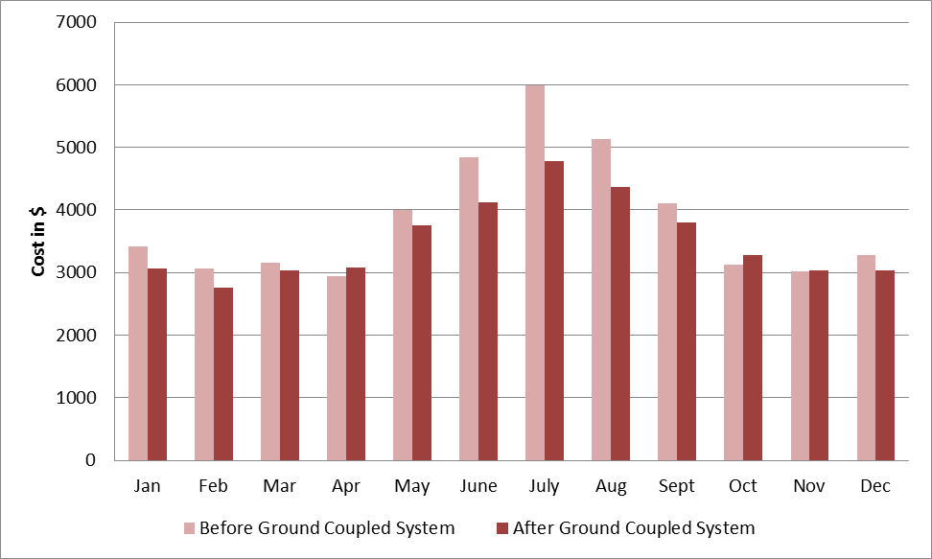
The Medical Office Building Cost Analysis - Wells
Overview
Existing Conditions
Ground Coupled Depth
System Design Options
Cost Analysis
Structural Breadth
Joist Redesign
Girder Redesign
Cost
Conclusion
Utility cost after - $42,115
Savings - $3,945
 | Vertical Well | Horizontal Well
Cost per Unit Length | $10.57 | $1.12
Total Length | 10,702 | 10,800
Pipe & Fitting Cost | - | $6,048
Total Cost | $114,156 | $18,144
Simple Payback | 28.9 years | 4.6 years
Discounted Payback | - | 4.9 years

Slide 11
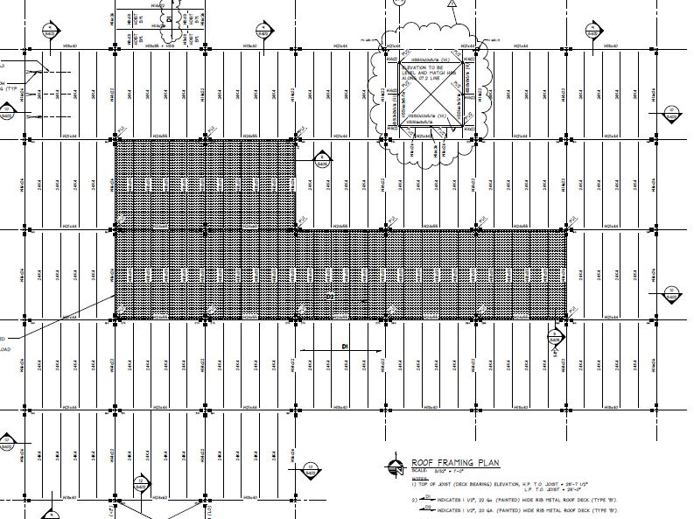
The Medical Office Building Loads & Original Design
Overview
Existing Conditions
Ground Coupled Depth
System Design Options
Cost Analysis
Structural Breadth
Joist Redesign
Girder Redesign
Cost
Conclusion
24K4 Roof Joist
W18X35 Mechanical Joist
Loads
Snow Load – 20psf
Live Load – 30psf
Dead Load – 8psf
Collateral – 7psf
Mechanical Dead Load – 75psf

Slide 12
The Medical Office Building Joist Redesign
Overview
Existing Conditions
Ground Coupled Depth
System Design Options
Cost Analysis
Structural Breadth
Joist Redesign
Girder Redesign
Cost
Conclusion
42nd Edition Catalog of Standard Specifications and Load and Weight Tables for Steel Joists and Joist Girders
New Joists: 20LH08

Slide 13
The Medical Office Building Girder Redesign
Overview
Existing Conditions
Ground Coupled Depth
System Design Options
Cost Analysis
Structural Breadth
Joist Redesign
Girder Redesign
Cost
Conclusion
Original Girders
W24X55 Edge
W24X68 Center
$M_{u}=\frac{wl^{2}}{8}$
Redesign Girders
W21X55 Edge
W21X73 Center

Slide 14
The Medical Office Building Cost Comparison
Overview
Existing Conditions
Ground Coupled Depth
System Design Options
Cost Analysis
Structural Breadth
Joist Redesign
Girder Redesign
Cost
Conclusion
Savings of $32,724
Original Design
Member | Cost per Member | # of Members | Total Cost
W18X35 | $1,530.00 | 28 | $42,840.00
W24X55 | $2,640.00 | 10 | $26,400.00
W24X68 | $2,970.00 | 2 | $5,940.00
 |  |  | $75,180.00
Redesign
Member | Cost per Member | # of Members | Total Cost
20LH08 | $522.00 | 28 | $14,616.00
W21X55 | $2,190.00 | 10 | $21,900.00
W21X73 | $2,970.00 | 2 | $5,940.00
 |  |  | $42,456.00

Slide 15
The Medical Office Building Conclusion/Recommendations
Overview
Existing Conditions
Ground Coupled Depth
System Design Options
Cost Analysis
Structural Breadth
Joist Redesign
Girder Redesign
Cost
Conclusion
Ground coupled system
Saves $3,945/year
Vertical Well – Payback of 28.9 years
Horizontal Well – Payback of 4.9 years
Roof framing redesign
20LH08 Joists
W21X55 and W21X73 Girders
Save $32,724

Slide 16
The Medical Office Building Acknowledgements
Overview
Existing Conditions
Ground Coupled Depth
System Design Options
Cost Analysis
Structural Breadth
Joist Redesign
Girder Redesign
Cost
Conclusion
Dr. Donghyun Rim – Advisor
Kurt Hutter - Anchor Health Properties
Randy Cook - The Procz Group Inc.
Family and Friends

Slide 17
The Medical Office Building Appendices - Charts
Overview
Existing Conditions
Ground Coupled Depth
System Design Options
Cost Analysis
Structural Breadth
Joist Redesign
Girder Redesign
Cost
Conclusion
 | Electric (kWh) | Gas (kBtu) | Total Building Energy (kBtu/yr)
Heating | - | 709,240 | 709,240
Cooling | 204,744 | - | 698,791
Lighting | 529,746 | - | 1,808,024
Receptacles | 115,781 | - | 395,161
 |  |  | 3,611,216
 | Summer Design Cooling (0.4%) | Winter Design Heating (99.6%)
Outdoor Air Dry Bulb (°F) | 92.4 | 9.4
Outdoor Air Wet Bulb (°F) | 74.1 | -
Indoor Air Design Temp (°F) | 75 | 72

Slide 18
The Medical Office Building Appendices - Charts
Overview
Existing Conditions
Ground Coupled Depth
System Design Options
Cost Analysis
Structural Breadth
Joist Redesign
Girder Redesign
Cost
Conclusion
 | Vertical Well | Horizontal Well
Cost per Unit Length | $10.57 | $1.12
Total Length | 10,702 | 10,800
Pipe & Fitting Cost | - | $6,048
Total Cost | $114,156 | $18,144
Simple Payback | 28.9 years | 4.6 years
Discounted Payback | - | 4.9 years
 | Original Units | New Units
Cost per Unit | $62,650 | $24,975
Number of Units | 2 | 5
Total Cost | $125,300 | $124,875
Well Depth (ft) | Required Length | Number of Wells
100 | 10702 | 108
200 | 10702 | 54
300 | 10702 | 36

Slide 19
The Medical Office Building Appendices - Charts
Overview
Existing Conditions
Ground Coupled Depth
System Design Options
Cost Analysis
Structural Breadth
Joist Redesign
Girder Redesign
Cost
Conclusion
Original Design
Member | Cost per Member | # of Members | Total Cost
W18X35 | $1,530.00 | 28 | $42,840.00
W24X55 | $2,640.00 | 10 | $26,400.00
W24X68 | $2,970.00 | 2 | $5,940.00
 |  |  | $75,180.00
Redesign
Member | Cost per Member | # of Members | Total Cost
20LH08 | $522.00 | 28 | $14,616.00
W21X55 | $2,190.00 | 10 | $21,900.00
W21X73 | $2,970.00 | 2 | $5,940.00
 |  |  | $42,456.00

Slide 20
The Medical Office Building Appendices - Figures
Overview
Existing Conditions
Ground Coupled Depth
System Design Options
Cost Analysis
Structural Breadth
Joist Redesign
Girder Redesign
Cost
Conclusion

Slide 21
The Medical Office Building Appendices - Figures
Overview
Existing Conditions
Ground Coupled Depth
System Design Options
Cost Analysis
Structural Breadth
Joist Redesign
Girder Redesign
Cost
Conclusion

Slide 22
The Medical Office Building Appendices - Figures
Overview
Existing Conditions
Ground Coupled Depth
System Design Options
Cost Analysis
Structural Breadth
Joist Redesign
Girder Redesign
Cost
Conclusion

Slide 23
The Medical Office Building Appendices - Figures
Overview
Existing Conditions
Ground Coupled Depth
System Design Options
Cost Analysis
Structural Breadth
Joist Redesign
Girder Redesign
Cost
Conclusion

